Slide 1

2014 Presentation
Humana Prescription
Drug Plan
Y0040_SPM_SPRE_PDP_14 Approved
GNHH4C1HH_14

Slide 2

Let’s talk about . . .
Medicare Part D prescription drug plans
Important dates to remember
How to get your drug coverage
Humana prescription drug coverage
Where to find information
Notes:
Agents, these are potential remarks. This is NOT a script that must be read. However, required statements are noted for your benefit.
Humana is a private company with a Medicare contract to provide Prescription Drug Plans to Medicare beneficiaries.
•Doctors have come to rely on prescription drugs to treat many conditions, and the cost of drugs keeps going up so it’s likely you’re spending more on medicine than ever before.
• In fact, most people with Medicare currently need, or will come to need, prescription drugs to stay healthy.
• Medicare Part D prescription drug coverage can help protect them – and you – from high out-of-pocket costs.
I’ll guide you through the enrollment process. There’s no pressure. My goal today is to answer your questions and help you determine if
a Humana plan fits your needs.
Part of my job is to share Medicare information with as many people as possible. Please think of your friends and associates who need this important information.
To take advantage of Medicare prescription drug coverage, you’ll need to weigh your options as related to your needs, and then choose a plan you’re comfortable with.
Here’s what we’ll cover today:
• First, I’ll give you the basics on Medicare’s prescription drug coverage
• Then we’ll talk about some important dates you need to know
• We’ll talk about the various ways you can get coverage – and how your current situation might affect your options
• We’ll discuss the plans Humana will offer in 2014
• Finally, I’ll tell you where you can find more information

Slide 3
Medicare Part D prescription drug coverage
Humana and other private insurance companies approved by Medicare offer Medicare Part D plans.
You can get Medicare Part D coverage even if you haven’t had prescription drug coverage in the past.
Prescription drug coverage is an option available to everyone entitled to Medicare Part A and/or enrolled in Part B.
If you’re already enrolled in a Medicare Advantage plan that includes drug coverage (MAPD), you don’t have to take any action. You’ll be enrolled in a new prescription drug plan automatically when your plan renews.
You can only be enrolled in one Medicare Part D plan at a time
To get Medicare prescription drug coverage, you must:
Have Medicare Part A and/or Part B
Live in the plan’s service area
Enroll in a Medicare-approved prescription drug plan (PDP) or Medicare Advantage with Prescription Drug Plan offered by a Medicare Advantage (MAPD) organization
Notes:
So, let’s get into the basics
•The Medicare prescription drug plans are available only from private insurance companies approved by Medicare to offer them.
• If you skipped getting Part D coverage when you were first eligible and didn’t have other creditable drug coverage, you’ll have a penalty added to your premium. You can still enroll, though. And you should. The penalty keeps increasing as time goes by. As an agent be prepared to inform prospect about what the penalty amount is.
• Medicare prescription drug coverage is available to everyone with Medicare – that means Medicare Part A, or Part B, or both. Do you meet this requirement? May I please see your Medicare card or letter that confirms you have Medicare?
• This almost goes without saying, but to enroll in a prescription drug plan from any insurance company, you need to live in an area served by that insurance company. That’s what we mean by the “plan’s service area.” Are you a full time resident of this service area? This plan’s service area is ________________.
• To get prescription drug coverage, you need to join a Medicare-approved plan, offered by a Medicare-approved organization. So, at this point, I want to assure you that Medicare has approved Humana’s prescription drug plans – and has also given Humana approval to sell them!
• By the way, do you currently have Medicare Part D drug coverage? You can only enroll in one Part D plan at a time. When you enroll with Humana, it will terminate any other Medicare Part D coverage you have.

Slide 4
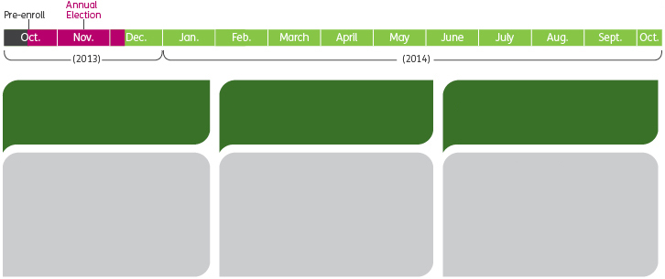
2014 Plan Year - Medicare Timeline
Pre-Enrollment:
Oct. 1 – Oct. 14, 2013
Annual Election:
Oct. 15 – Dec. 7, 2013
Jan. 1 – Oct. 14, 2014
Compare your plan options and costs, so you’ll be ready to enroll by Oct. 15.
If you’re eligible, you can enroll in a prescription drug plan (PDP) or change to a new PDP during this time
You’re not allowed to make a plan change unless special circumstances arise (e.g., you move, you qualify for or lose eligibility for Medicaid).
Note: This information doesn’t apply to Medicare Supplement Plans
Notes:
Let’s talk about when you can join a plan.
• If you are aging in, you can enroll in 2014 Medicare health benefits, such as a PDP or Medicare Advantage plan during the three months before and the three months following your 65th birthday.
• If you have PDP coverage but want to make a switch, you can enroll in a new plan between Oct. 15 and Dec. 7, 2013 for coverage beginning Jan. 1, 2014. This is the Annual Election Period. During this period, you can also change plans or enroll in a separate prescription drug plan. Additionally, you can elect or enroll in any plan:
• Original Medicare + PDP
• Original Medicare + Medicare Supp + PDP
• Medicare Advantage + PD
• Dec. 7 is the last day to enroll in or change Part D coverage for 2014; The exception may be qualifying events.
• Unless a special election period applies to you, such as if you move, you’ll have the PDP coverage you’re enrolling in today for all of 2014. Is that clear?

Slide 5

How to get drug coverage
You can get prescription drug coverage several ways:
Prescription drug plan (PDP) as a stand-alone plan
A stand-alone PDP gives you prescription drug coverage, but no other medical benefits
You can use a stand-alone PDP with Original Medicare or with Original Medicare plus a Medicare Supplement (Medigap) plan
You can use a stand-alone PDP with a Private-Fee-for-Service (PFFS) plan that doesn’t contain drug coverage
As a part of a Medicare Advantage plan
Also referred to as Medicare Advantage + Prescription Drugs (MAPD)
As a part of your retiree benefit package, if available from your former employer or union
Notes:
Now let’s talk about how you get prescription drug coverage.
Again, the choice is yours. The best thing to do is for you to match your particular prescription drug needs to the choices available to you.
Read the page. Discuss, answer any questions.

Slide 6
Medicare-defined basic benefit
Medicare defines a minimum benefit all carriers must offer, all Part D plans offer benefits equal to or better than the following:
2014 Medicare Prescription Drug Plan - Basic Coverage
 | 2014 Basic Benefits | You Pay
Deductible | $310 | 100% of first $310
Initial Coverage Limit | $2,850 | 25% of the next $2,540 ($635)
Coverage Gap* | $3,605 | 47.5% of covered brand name and 72% of generic drugs of the next $3,605 until the cumulative out-of-pocket costs reach $4,550
Annual Out-of-Pocket Amount | $4,550**
Catastrophic Coverage | Medicare and Plan 95% | $2.55 for generic/multiple-source drug and $6.35 for all other drugs; or 5% coinsurance, whichever is greater
* See Coverage in the Gap on following slide
** Annual Out-of-Pocket Amount doesn’t include monthly premiums.
Notes:
This chart contains words and numbers that are unfamiliar to most people. It represents what CMS calls its benchmark drug benefit. In order for CMS to approve a drug plan, it has to be at least this good.
The chart is telling you that if you select a stand-alone PDP or even a Medicare Advantage plan with drug coverage, you have the confidence of knowing that the drug benefit in your plan is at least as good as the benchmark and how the benchmark coverage works. There shouldn’t be surprises for you later on. The drug benefit has been reviewed and approved by CMS.
You’ll see that the benefit has four phases. You’ll move from one level to the next based on drug costs and your spending. I’ll explain these in more detail when we go through your Humana drug plan benefits.
I’ll show you how the Humana drug benefit matches and may even exceed the benchmark benefit.

Slide 7
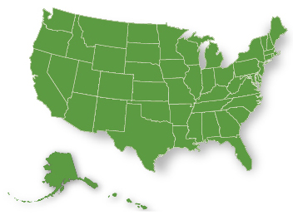
Wherever you are, we’re there for you
In 2014, Humana will offer three different stand-alone prescription drug plans in each region.
All these plans meet the requirements set down by Medicare
Plan availability and benefits will vary by region.
More than 60,000 in-network pharmacies nationwide
Including more than 20,000 independent pharmacies. You’re likely to find one near you.
Original Medicare
ID Card
Medicare Part D
ID Card
Notes:
So we’ve covered the basics about how and when to get prescription drug coverage. Now let’s take a look at the prescription drug plans available from Humana for 2014.

Slide 8
Options that make sense
  Humana Enhanced PDP
  If you prefer a prescription drug plan with no deductible, retail pharmacy copays as low as $2, and mail order copays as low as $0, you should explore Humana’s Enhanced plan. You must use network pharmacies, except under non-routine circumstances.
  Humana Preferred Rx Plan
  Join the Preferred Rx Plan and enjoy copays as low as $1 at preferred retail pharmacies (after deductible) and pay only a penny for select generic hypertension drugs.
  Humana Walmart Rx Plan
  Humana and Walmart are committed to your health and your wallet. This plan features a low monthly premium and no deductible on preferred and non-preferred generic medicines.
Notes:
I’m here to help you understand, based on your needs, the Prescription Drug Plan that may be right for you. Let’s discuss the options.

Slide 9
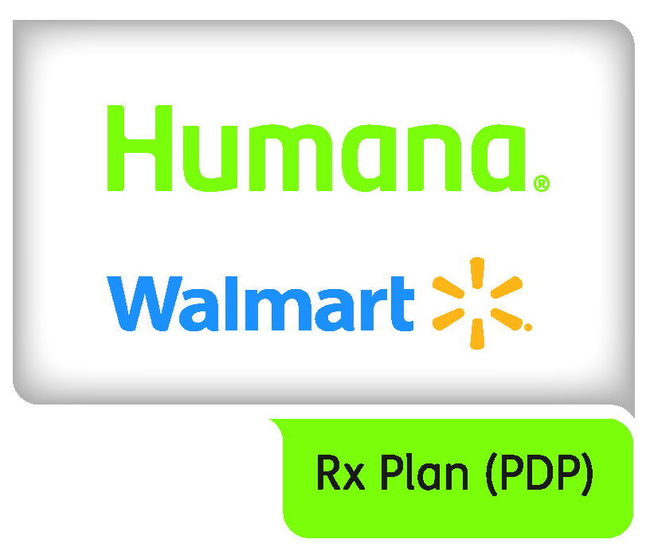
Humana and Walmart team up for you
Humana and Walmart have come together to bring you stand-alone prescription drug plans at a very affordable price.
Get the service and value you expect from Walmart with professional pharmacists and automatic refills
These two value-driven companies are now working together to offer you the following benefits:
Savings within Humana’s preferred retail pharmacy network* of more than 4,000 Walmart, Sam’s Club, Walmart Neighborhood Market and Walmart Express pharmacies
Plans designed to help you save money when you use generic drugs
Convenience combined with savings from Humana-owned RightSource® – the preferred mail-order pharmacy – with copayments starting as low as $0**
* Other pharmacies are available in our network.
** Applies only to drugs covered by Part D, after deductible (if applicable),
at preferred pharmacies
Notes:
With Humana Walmart-Preferred Plans, you get possible cost savings, convenience, and confidence in knowing your prescription plan
is backed by two of the nation’s most experienced companies.

Slide 10
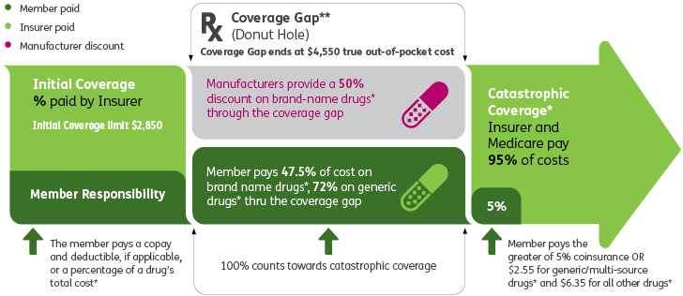
Get to Know the Coverage Gap
Chances are, you’ve heard of the Medicare prescription drug “coverage gap” - also called the “donut hole.” The coverage gap is the period when you have to pay part of your drug costs- and before additional Medicare coverage kicks in.
* applies only to drugs covered by the selected plan
**some plans have additional coverage while the member is in the gap.
Notes:
Discount program for brand-name medicines
CMS works with drug companies and Part D plans to give you 52.5 percent off on covered brand-name prescriptions while you’re in the coverage gap.
Coverage in the gap for generic medicines
CMS partners with health plans to help you pay for generic drugs while you’re in the coverage gap. You’ll have 28 percent of the cost covered.
If you receive a low-income subsidy or have an employer-sponsored retiree drug plan – with the exception of employer groups
with waivers – you won’t be eligible for this discount.
Any questions before we move on?

Slide 11
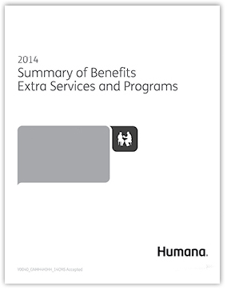
Humana Prescription Drug Plans
The person discussing plan options with you will review the following important documents:
2014 Summary of Benefits
2014 Prescription Drug Guide
Notes:
Our goal today is to find a plan that best meets your needs and budget
Humana competes for your business, which may enable you to receive more benefits, extras and reduced out-of-pocket costs.
Guidance:
• Present the PDP Enrollment Book.
• Next, present the PDP summary of benefits.
• Summarize the difference between the PDPs.
• When the person decides which one is of interest, explain the benefit.
You are NOT required to explain the drug benefit for each PDP choice.
Before we move on, any new questions?

Slide 12
Enjoy extra value and possible savings
  If you enroll in one of Humana’s prescription drug plans, you get these services at no extra cost:
  Mail-order pharmacies, like Humana-owned RightSource®*
  SmartSummary Rx® benefit summary
  Online tools on Humana.com and m.humana.com
  Tips by phone through Maximize Your BenefitSM Rx
  It’s the extras Humana provides** that make our plans such a great value.
  Dental, vision and hearing care discounts
  Prescription discounts
  * Other pharmacies are available in our network
  ** The products and services described above are neither offered nor guaranteed under our contract with the Medicare program. In addition, they aren’t subject to the Medicare appeals process. Any disputes regarding these products and services may be subject to the Humana grievance process.
Notes:
Mail-order pharmacies, like Humana-owned RightSource, may save you money and are convenient. Your maintenance medicines will be mailed to you and may be less. RightSource is the preferred mail order pharmacy for most Humana PDP plans and has over 400 pharmacists available to answer questions about your prescriptions.
With your Humana plan, you’ll also receive a SmartSummary that gives you valuable, easy-to-read information that includes tips to help you save money.
MyHumana is your secure website at Humana.com where you can:
View details about your plan, benefits, and claims
Select how you would like to receive communications from us – via U.S. mail, email, text
Access tools that can help you plan, budget, and estimate healthcare expenses, such as the Drug Pricing Tool and the Rx Calculator
Get health and wellness information, and more!
m.humana.com is Humana’s mobile web address. If you use a web-enabled cell phone, you can download several helpful apps here.
For example, there’s one that allows you to compare the cost of a particular drug from all available sources. Shopping can pay off!

Slide 13
If you choose to enroll with Humana
Here’s what happens next:
  Complete an application
In the next two weeks:
Humana processes your application and confirms your eligibility
You’ll receive a verification call for each enrollee in the household
Medicare confirms your enrollment
Receive your Humana member identification (ID) card
Member Benefit Package arrives
in your mailbox
In the months to come:
Your Humana agent calls you
You’ll receive your Evidence of Coverage
Notes:
To close - summarize the notes from your needs analysis and how Humana meets those needs. “Are you ready to enroll today?”
If Not Ready to Enroll
What’s your reservation about enrolling? Tell me your concerns or what you’re feeling. Let’s talk it out.
• Whatever you decide is fine by me. However, I don’t want you to miss out on a great plan because I didn’t explain something thoroughly enough or speak to your concerns. There’s no pressure to enroll.
Explain the Verification Call Process, and the fact that Humana will attempt to reach each enrollee three times. Reference/tear out the informational card within the Enrollment Book
Two things before we wrap up:
I will help your friends and others the same way I’ve helped you today, with the same level of service. Please recommend me. Recommendations are an important part of my business. Here are some business cards for you to share with your friends.
I’d like to contact you about other ways Humana and I can help. If you’ll fill out this Member Authorization Form, it gives me permission to tell you about other products Humana offers that you may be interested in. (It is NOT required but we hope they will choose to give us permission to contact them.)

Slide 14
How to get drug coverage
  Warning!
  If you’re enrolled in a Medicare Advantage (MA) plan with prescription drug coverage and then enroll in a stand-alone PDP, you’ll automatically be disenrolled from your MA plan.
  This is the case unless you have a:
  Private-Fee-for-Service (PFFS) plan with no prescription drug coverage
  Medical Savings Account MA plan
  1876 Cost Plan
  Wonder if you can afford your prescription medicines? You may qualify for money the federal government has set aside to help people with their drug expenses:
  1-800-MEDICARE (1-800-633-4227). TTY users call 1-877-486-2048, 24 hours a day, seven days a week
  The Social Security office at 1-800-772-1213. TTY users should call 1-800-325-0778,
  Monday – Friday, 7 a.m. – 7 p.m.
  Your state Medicaid office
Notes:
Earlier I mentioned you can get prescription drug coverage as part of a Medicare Advantage plan.
So if you already have a Medicare Advantage plan that includes prescription drug coverage, you don’t have to do anything. You’ll be enrolled in prescription drug coverage automatically. If you enroll in a separate prescription drug plan, you could lose your Medicare Advantage coverage. The only exceptions are listed here.
Many people do qualify for extra help. Make the call to find out if you’re one of them.

Slide 15

Questions?
  Thanks for your time and attention.
  Where to find information:
  “Medicare and You 2014” handbook (available in October or November 2013)
  www.medicare.gov
  Your local State Health Insurance
  Program (SHIP)
  Humana-Medicare.com
Notes:
If you need information, either before or after you’ve enrolled in a plan, you can go to any of these sources:
• Your “Medicare and You 2014” handbook, which you should receive in the mail from the Centers for Medicare and Medicaid Services.
• The Medicare website, www.medicare.gov, contains a lot of helpful information about Medicare benefits and prescription drug plans.
• You can call 1-800-MEDICARE (1-800-633-4227) or its TTY line (1-877-486-2048) to get answers to your questions.
• And you can call your local State Health Insurance Program. [You may want to provide the SHIP phone number for your state, to save your audience the trouble of having to look it up. Ask them to write the number down in case they should ever need it.]
• You can also call Humana at 1-800-337-0953 (TTY: 711) for any questions about our plans.

Slide 16
  Humana is a stand-alone prescription drug plan with a Medicare contract. Enrollment in this Humana plan depends on contract renewal. The benefit information provided is a brief summary, not a complete description of benefits. For more information contact the plan. Limitations, copayments and restrictions may apply. Benefits, formulary, pharmacy network, premium and/or co-payments/co-insurance may change on January 1 of each year. You must continue to pay your Medicare Part B premium.
  This information is available for free in other languages. Please call our customer service number at 1-800-281-6918 (TTY: 711). Hours are 8 a.m. to 8 p.m., seven days a week through Feb. 15, 2014 and
  8 a.m. to 8 p.m. Monday – Friday the rest of the year.
  Esta información está disponible gratuitamente en otros lenguajes. Póngase en contacto con nuestro Departamento de Atención al Cliente al 1-800-281-6918 (TTY: 711) si desea mayores informes. El horario es de 8 a.m. a 8 p.m., los siete días de la semana hasta el 15 de febrero de 2014 y de 8 a.m. a 8 p.m. de lunes a viernes por el resto del año.
GNHH4C1HH_14
Notes:
Thank you for meeting with me today.
Note – if the person didn’t enroll:
The plan wasn’t right for you today but it may be in the future. Or, another one that Humana offers may meet your future needs.
Please stay in touch with me. I want to be your Humana agent. You have my business card.

